Slide 1

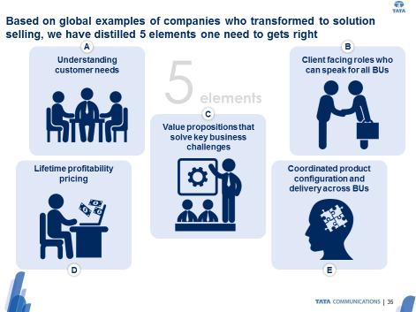
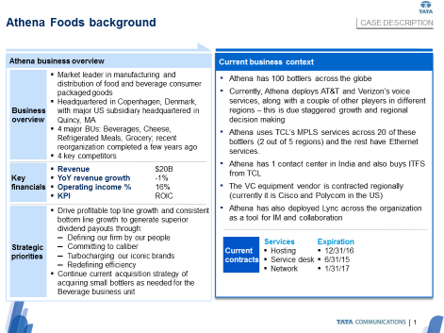
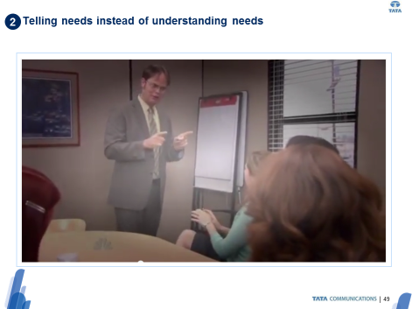
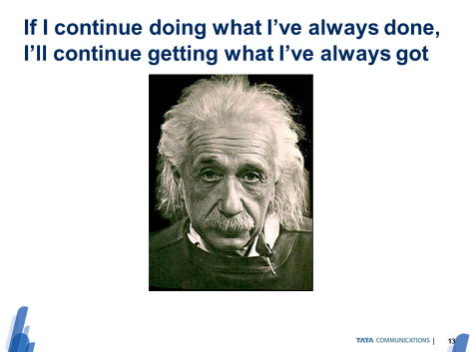
At CLIENT, our tools enabled to tailor and rollout a training program to >120 sales professionals in a 3 week effort
Telecommunications (TMT) | Asia-Pacific
TEL007
c
The challenge
Tools we brought and tailored
Impact
Aggressive growth targets requiring solution selling at scale …
45% growth aspiration
… while the salesforce focused on short term RfPs only …
Large deals only 38% of revenue
Partnerships only 13% of revenue
… and lacked both will and skill to change
Tendency to externalize challenges with solution selling
Previous training in theory, but no practice
2-day training program grounded in value proposition cookbook methodology
>120 people trained in 5 sessions across regions in 3 weeks
8 step methodology institutionalized, creating clarity in collaboration and reviews
Monthly platform for peer-to-peer reviews of value propositions and account plans
1 client specific practice case, leveraging insights from pilot cases
6 role plays for direct feedback on actual behavior
3 mindset change modules to increase sense of ownership

